Slide 1
Analysis of SuperStore
Visualization Project
A Supermarket Sales Dataset
Presented by : Maithreyee B Bharadwaj
Email : maithreyee95@gmail.com
Date: 6th August 2023

Slide 2
Problem Statement
I am a data analyst working for a store called as SuperStore in the USA. My manager asks me to get the information about the store’s performance from 2014 to 2017, including products which are having the highest sales and profits. The goal is to find out the revenue and the profits of our stores which are present across various states in the country.

Slide 3
Analysis of the database
The table consists of the following information
Columns | 20
Rows | 9994
The various columns are order_id, order_date, ship_date, ship_mode, custoemr_id, customer-name, segment, country, city, state, postal_code, region, product_id, category, sub-category, product_name,sales, quantity, discount,profit
Below is a snapshot of the data

Slide 4
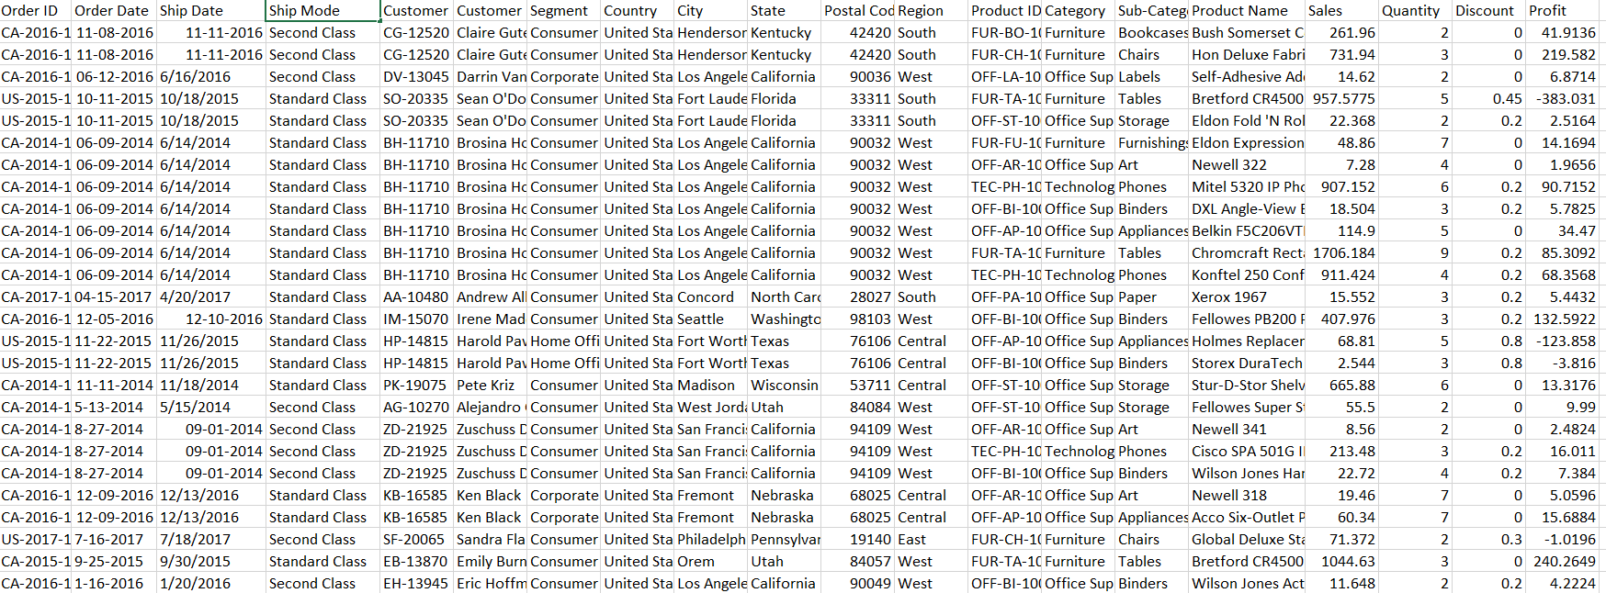
Summary of overall sales between 2014-2017:
The total revenue from the stores is $2.02 million.
The total profits from the stores is $0.27 million.
The total number of goods sold is 0.38 million.

Slide 5
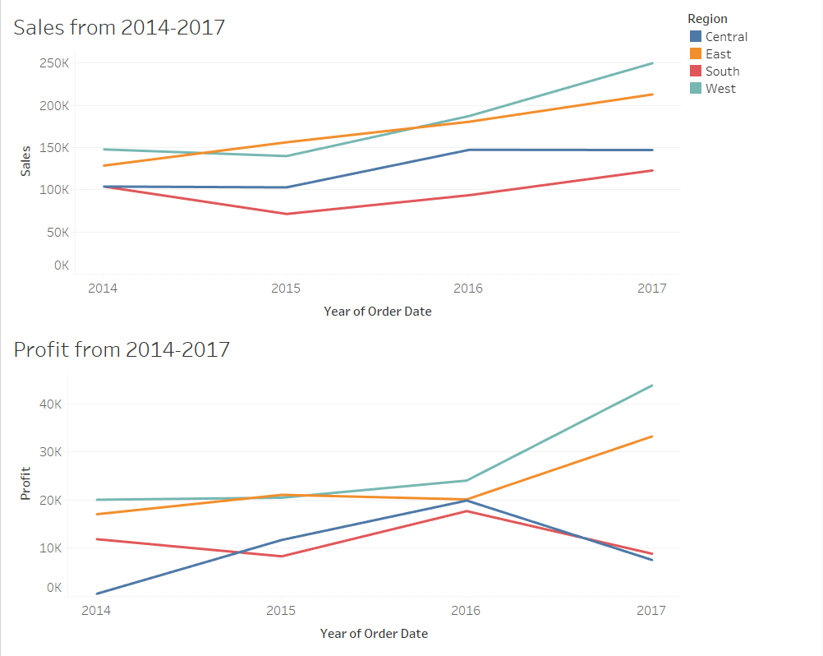
Sales and Profit with Respect to Regions
The graph has been plotted from the year 2014 to 2017.
The graph indicates the sales and profit from the four regions of the USA.
The sales graph tells us that South region has not been doing so well as compared to West or East.
The profits from South and Central regions have decreased from 2016 onwards.
Below is a table showing the sales and profit of each region
Region | Sales | Profit
West | $0.64 million | $0.10 million
East | $0.58 million | $0.089 million(89 thousand)
Central | $0.45 million | $0.043 million(43 thousand )
Sount | $0.35 million | $0.041 million(41 thousand)

Slide 6
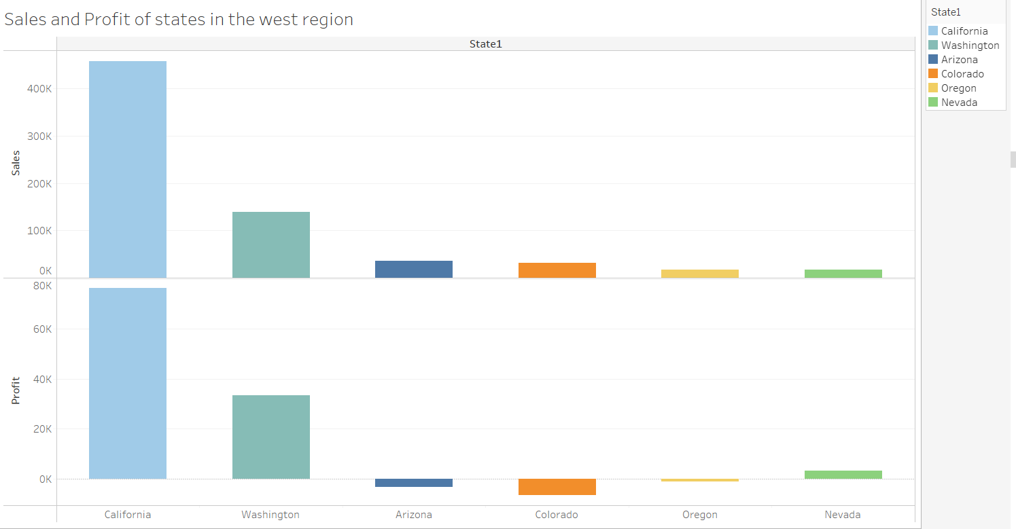
Top States with Respect to Sales and Profit in Each Region
West Region
One of the insights is that if the sales are high does not mean even the profits are high.
The top three countries in sales are:
1.California
2.Washington
3.Arizona
The example I would like to give is Arizona which takes the third spot in sales but it is incurring losses.
Nevada is 6th in sales but it is in the 3rd spot when it comes to profits.
I have selected the top 6 states with respect to sales.

Slide 7
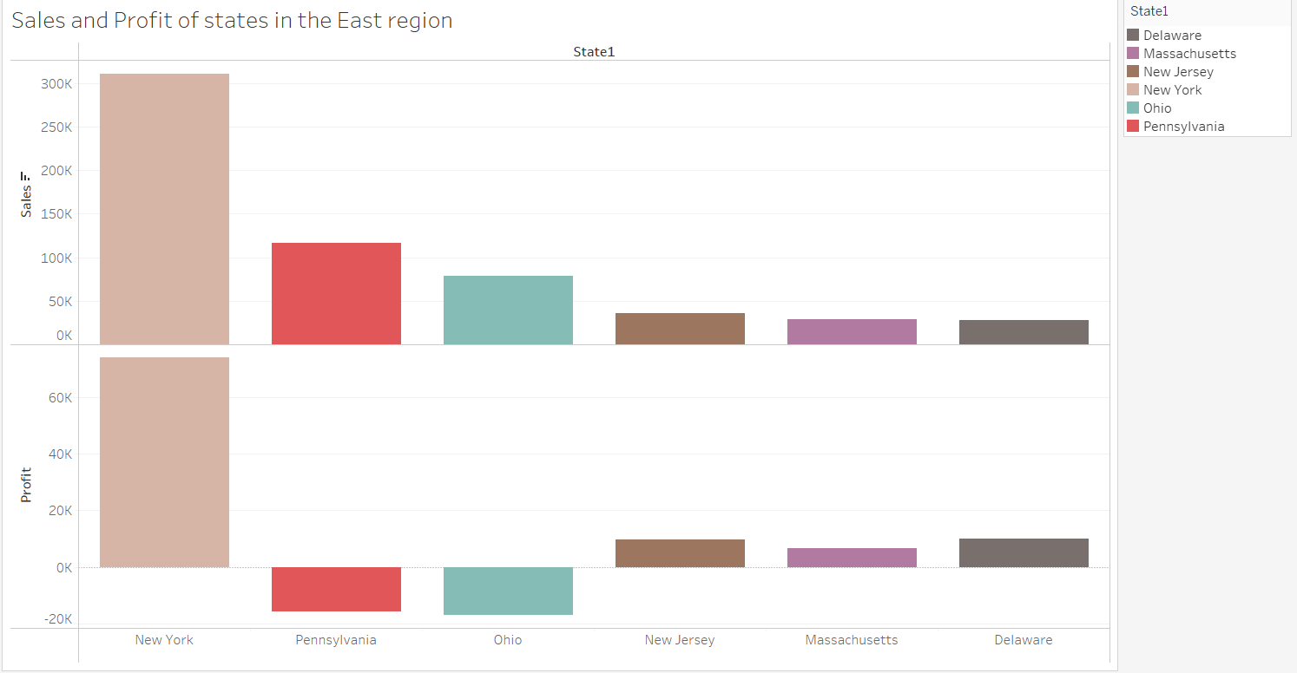
2. East Region
The top 3 countries with the highest sale in the east region:
1.New York
2.Pennsylvania
3.Ohio
In case of Pennsylvania and Ohio they have incurred a loss of $15K each.
New Jersey shows a profit of $9K.
Massachusetts shows a profit of $6.7K.
I have selected the top 6 states with respect to sales.

Slide 8
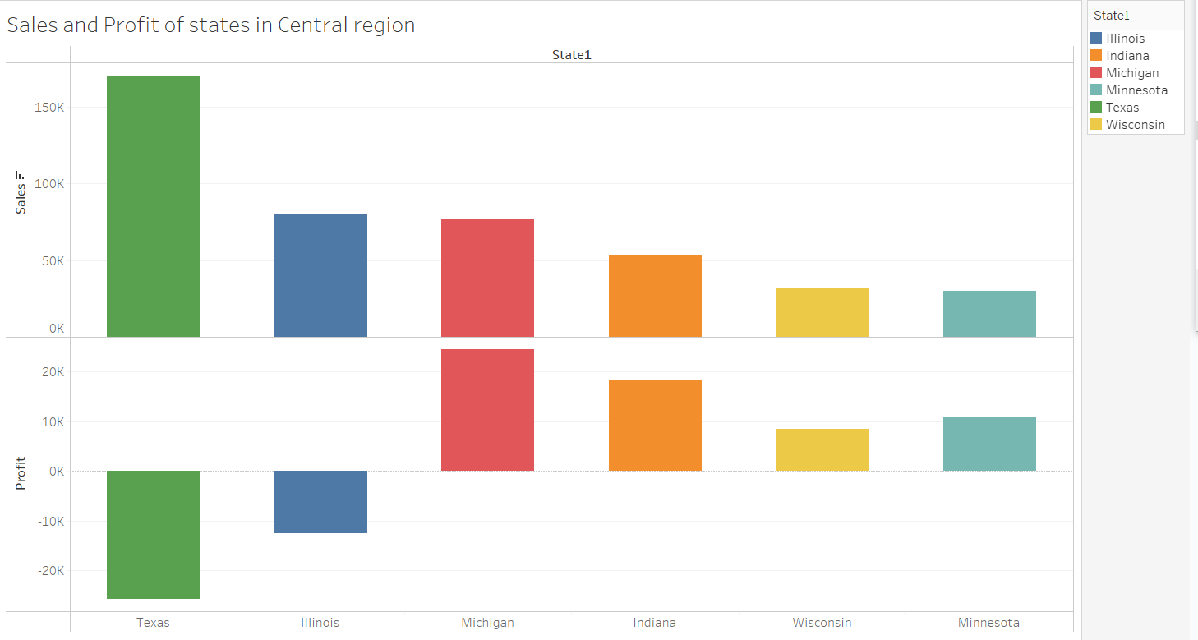
3. Central Region
The top three countries with respect to sales are :
1. Texas
2. Illinois
3.Michigan
The top 2 countries with the highest sales have incurred losses
Texas -Incurred a loss of $25K.
Illinois- Incurred a loss of $12K.
The top 3 countries with respect to profits are :
1.Michigan
2. Indiana.
3. Wisconsin
I have selected the top 6 states with respect to sales.

Slide 9
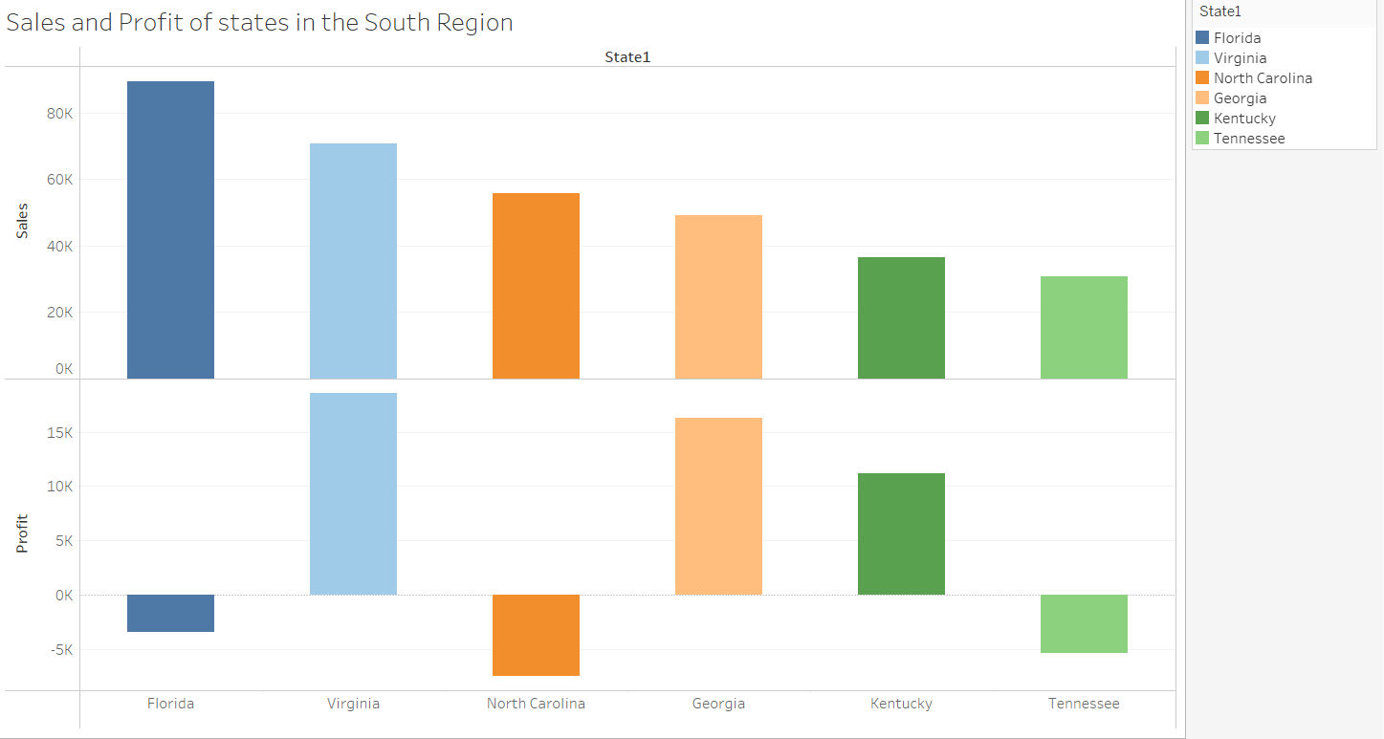
4. South Region
Top three countries with the highest sales are :
1. Florida
2. Virginia
3. North Carolina
With respect to profits the top three countries are
1. Virginia
2. Georgia
3. Kentucky
Florida has incurred a loss of $3.3K and North Carolina has incurred a loss of $7K.
This data is accumulated through 2014-2017.
I have selected the top 6 states with respect to sales.

Slide 10
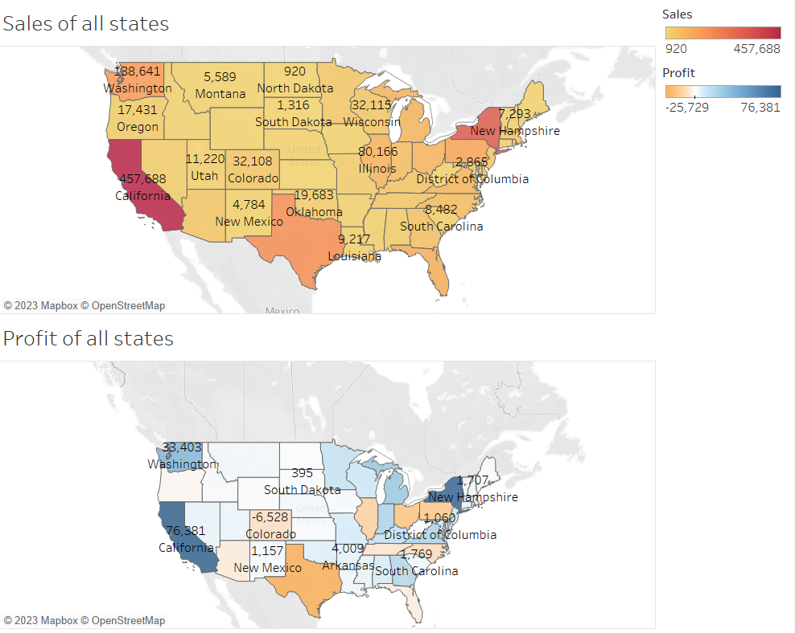
A Comparison Between the Sales and Profit of all the States
Here is just a graph showing the sales and profit of all the states.
It can be observed that California, New York, Washington and Texas are the states with the most sales.
In case of higher profits it is California, New York, Washington and Michigan.

Slide 11
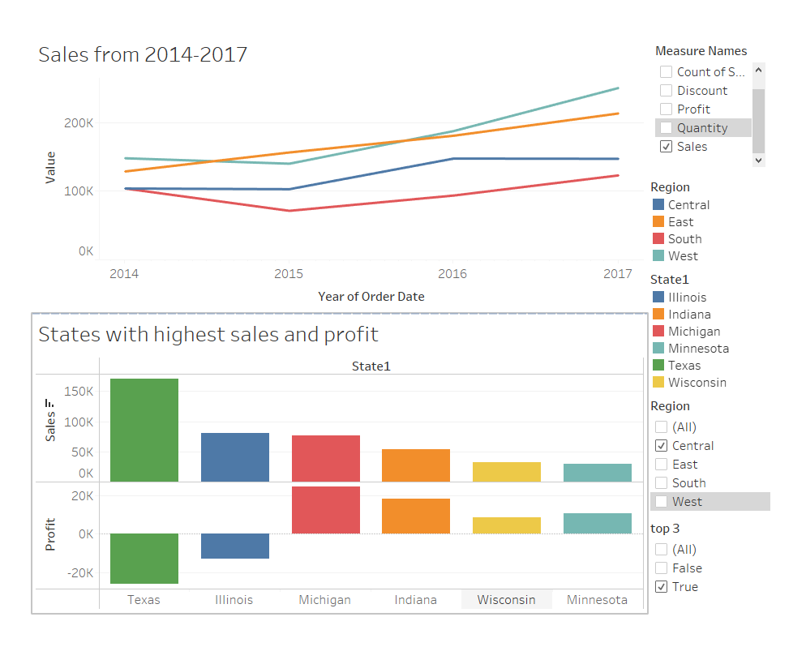
Dashboard
Here is the dashboard which shows the sales and profits of each of the region
Depending on the region which is selected the dashboard shows the top 3 states with the highest sales and profit

Slide 12
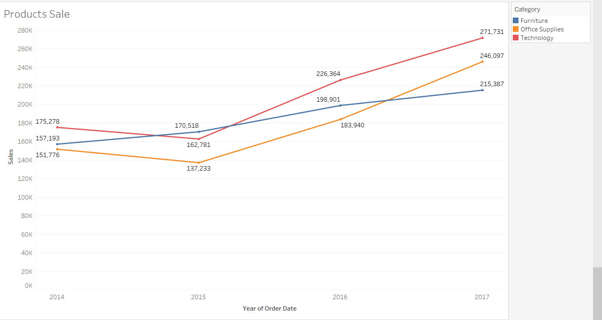
Sales of Our Products from 2014-2017
Our store products are under three categories which are:
1. Furniture
2. Office Supplies
3. Technology
The sales of Furniture have been steady over the years.
The sales of Technology and Office supplies dipped in 2015.
They there has been a gradual increase from 2015-2016 and 2016-2017.

Slide 13
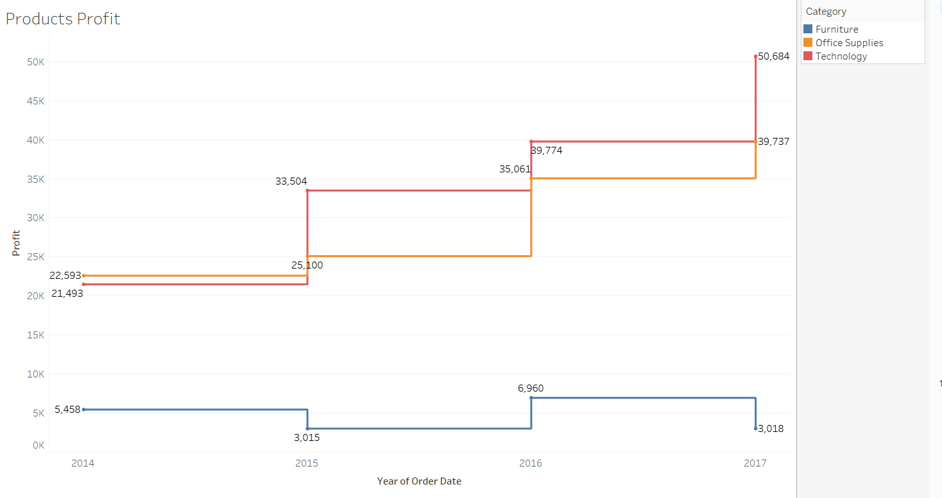
Profit of our Products from 2014-2017
Profits of the products are shown on the graph left side.
From the graph it can be understood that profits from furniture are really low.
Deeper analysis has to be done as to why products related to furniture are not giving much profits.
It can be observed that profits from office supplies and technology are steadily increasing .
Products related to Technology are showing higher profits.

Slide 14
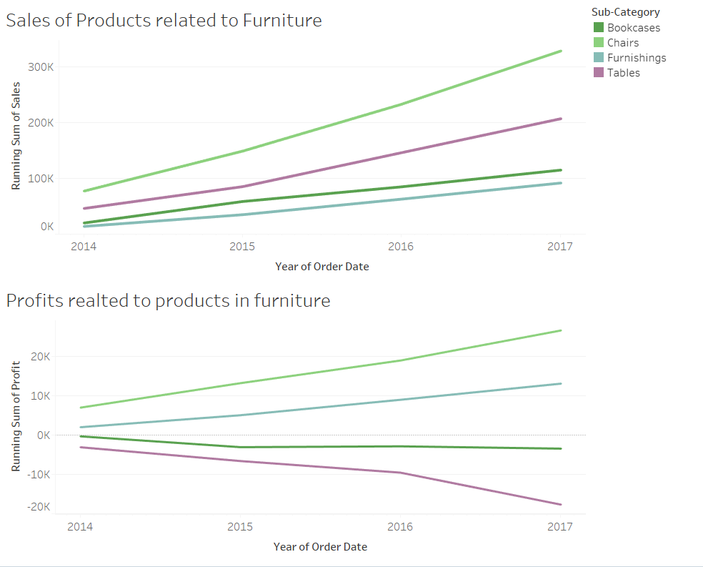
Sales and Profits Related to Furniture Products
The sales of products under Furniture category include :
1. Bookcases
2.Chairs
3.Furnishing
4.Tables
The sales of chairs are steadily increasing.
Sales of bookcases and furnishing are steadily decreasing . We should do more analysis on how to improve the sales of these two products.
Losses have been incurred with respect to tables and bookcases.

Slide 15
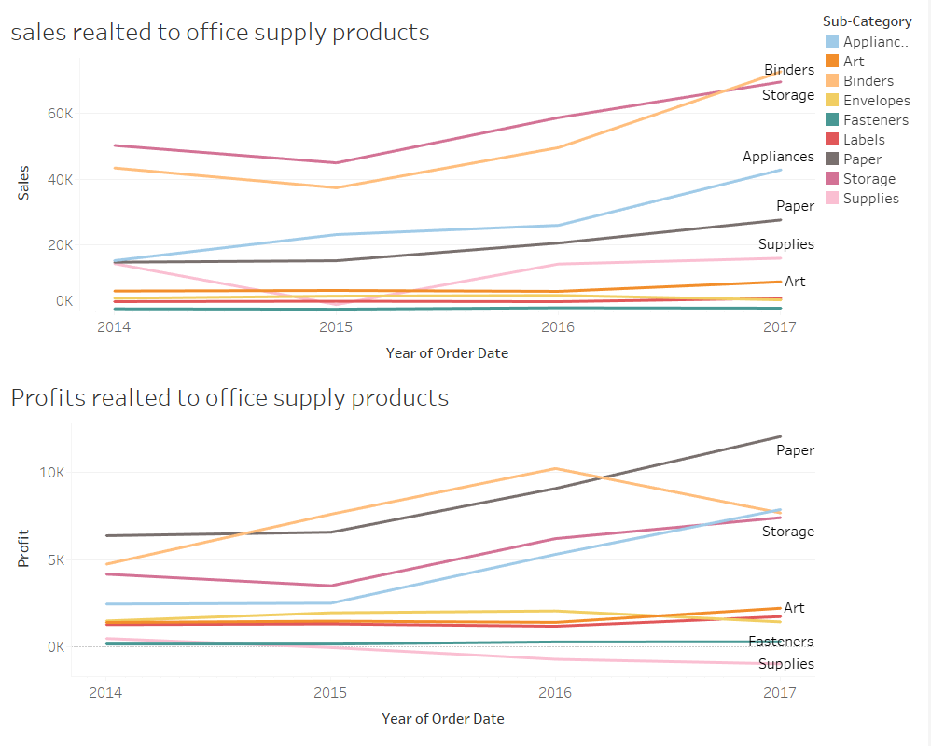
Sales and Profits Related to Office Supplies products
The graph indicates that sales of binders and storage having steadily been increasing over the years.
Sales of envelopes,fasteners and labels have not show any improvement .
In case of profits paper has shown the highest profits compared to its sales.
Following the next highest profits are binders and storage.
The supplies have incurred losses in 2016-2017.

Slide 16
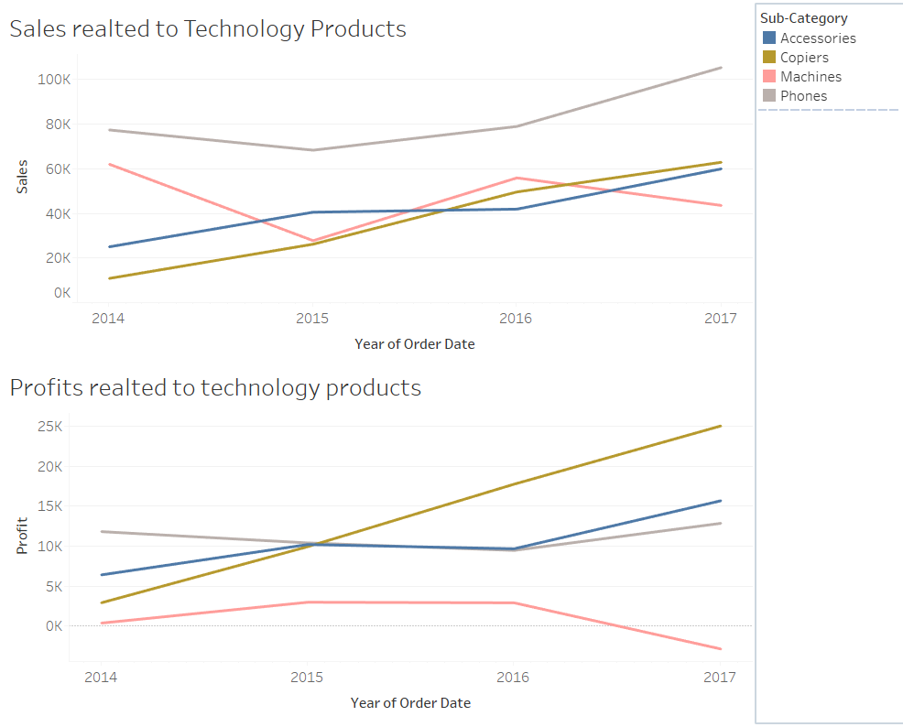
Sales and Profits Related to Technology Products
From the graphs it can be observed that sales of machines and accessories are consistently low for all the four years.
Phones sales have been steadily going up.
Copiers sales having been steadily going up in a very slow pace.
The graph tells us that machines have incurred a loss from 2016.
Copiers have provided with more profits then phones and accessories.

Slide 17
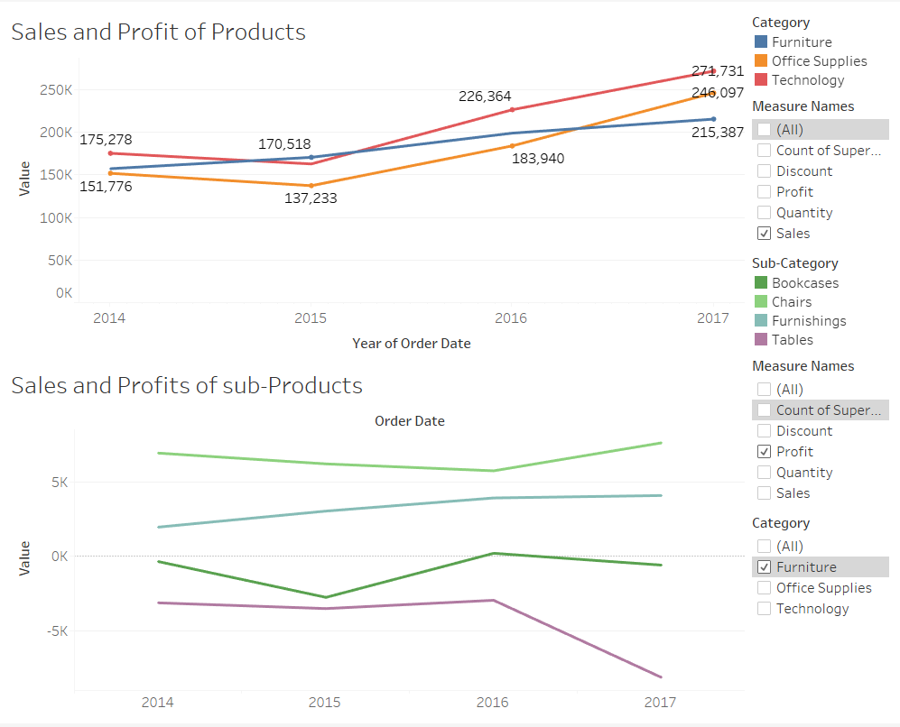
Dashboard
This dashboard shows us the sales and profit for each category and its sub-category
As you can see in the dashboard it shows the sales of the three categories as sales has been selected as the value to be measured.
The dashboard shows the profits of all the products that come under Furniture

Slide 18
Appendix
Tools used
Microsoft Excel
Tableau
MySQL
Dataset was obtained from Kaggle

Slide 19
THANK YOU

Slide 20
QUESTIONS

